Slide 1


AI or Die
The Future of Driving School Marketing and Operations
Presented By: Carrie Mae Nelson & Mav (2025)
Powered by:

Slide 2


POP QUIZ
Are You Currently Using AI?
I Don’t Know
AI:
Yes
No
“Guilty as charged.”

Slide 3

Driven By AI: The Moment We Are In
7 Years
Social Adoption
Internet:
TikTok:
9 Months
100 M Users
Instagram:
2.5 Years
AI:
Weeks
Business Adoption
78% of companies use AI (up from 55% in 23)
% Using AI
“The State of AI in Early 2024: Gen AI adoption spikes and starts to generate value.” McKinsey Global Survey, May 2024.

Slide 4
Generative AI could add up to US$4.4 trillion annually to the global economy.
Projections
75% of that falls into 4 business function categories:
“The State of AI in Early 2024: Gen AI adoption spikes and starts to generate value.” McKinsey Global Survey, May 2024.

Slide 5

Research & Development
Operations
Marketing & Sales
Software Engineering
“The State of AI in Early 2024: Gen AI adoption spikes and starts to generate value.” McKinsey Global Survey, May 2024.

Slide 6



AI Operations: Shift Your Way of Thinking
I do It Myself
We React
Info in People
The System Does It
Info is an Asset
We Predict
  Your job isn’t to respond to every text & call
  Anticipate student drop off before they ghost you
  Sandra knows parents, Trevor knows who to test
  Your job is to design the system
  Know when and where to hire instructors based on data
  AI stores, predicts, and acts on behavior and input
Notes:
AI doesn’t replace your team. It replaces your chaos.

Slide 7

AI As the Engine in Your School:
Client Management
1
2
3
Lead
Lesson
Lesson
Payment
Payment
Loyalty
  Capture Leads
  Send Personalized Messages Instantly
  Follows up automatically until scheduled
  Match Instructor to Student
  Develop lesson plans
  Predict cancellation and fill open slots
  Flags missed lessons or unpaid invoices
  Analyze reviews and feedback
  Send smart upsells (tests, etc)
  Track what works
Notes:
From first click to final test, AI keeps your business in gear.

Slide 8
AI as the Fuel in Your Business -
Basic Marketing/Sales
Smarter Ads
Instant Response
Consistent Brand
  AI analyzes what ads convert by time, suburb, and keyword
  Automatically shifts spend to what’s working — no guessing
  Tracks ROI from every click to every completed test
  Chatbots and SMS responders handle leads within seconds
  Personalized replies feel human — but they never sleep
  Converts night-time inquiries into morning bookings
  Auto-generates blog posts, social media posts, and email content
  Keeps your tone and brand voice consistent across channels
  Learns from engagement — improves every week
Notes:
“If AI can make your marketing smarter, imagine what it can do once the student walks through your doors.”

Slide 9
What About My SEO
How SEO Crawlers Work vs. How LLMs Learn and Retrieve Info
SEO Crawler
LLM “Seeker”
“Scan” code
Follow links
Index Keywords & Meta
“Look For” Technical Signals
Frequently Recrawl to Update
“Digest” Snapshots of info
Use Probability to associate
Find Relationships
“Look For” Context & Clarity
Occasionally Check in to Update
RANK
RECOMMEND

Slide 10
AI won’t fix everything:
Idealism vs Realism
“How many driving lessons does my kid need?”
-Every Karen on Earth

Slide 11


GROK Said:
The number of driving lessons a kid needs varies based on several factors, including their age, confidence, prior experience, and local requirements. Here’s a breakdown to help you gauge what’s needed:
  General Guidelines: Most sources suggest that new drivers need around 20–50 hours of supervised practice to become competent. For professional lessons, 10–20 sessions (each typically 1–2 hours) is common for beginners to reach a level where they can pass a driving test. The UK’s Driver and Vehicle Standards Agency recommends about 45 hours of professional lessons plus 22 hours of private practice for the average learner.
  Factors Influencing Lesson Count:
    Age and Maturity: Teens (16–18) often need more lessons due to limited experience, while older teens or those with some exposure (e.g., driving in parking lots) may need fewer.
    Learning Pace: Confident or quick learners may need fewer lessons (closer to 10–15), while nervous or slower learners might require 20–30 or more.
    State/Country Requirements: Some places mandate a minimum number of lessons or supervised driving hours. For example, in the U.S., states like California require 6 hours of professional instruction for teens under 18, plus 50 hours of supervised driving (10 at night). Check your local DMV or equivalent for specifics.
    Driving Conditions: Urban areas with complex traffic may require more lessons than rural settings.
    Test Readiness: Lessons often focus on preparing for the driving test, so the number depends on how quickly your kid masters skills like parallel parking, lane changes, and traffic rules.
  Practical Steps:
    Start with a professional instructor to assess your kid’s baseline skills. Many driving schools offer an initial evaluation.
    Combine professional lessons with supervised practice (you or another licensed adult). This can reduce the number of paid lessons needed.
    Look for signs of readiness: confidence in varied conditions (highways, city, night), smooth handling, and understanding of road rules.
    Ask the instructor for feedback after a few lessons to estimate how many more are needed.
  Cost Consideration: Lessons cost $50–$150 per hour depending on location and instructor. Balancing professional lessons with free supervised practice can save money.
Since I don’t know your location or your kid’s experience level, could you share those details? I can check local regulations or tailor the advice further. Alternatively, contact a local driving school for a personalized estimate based on an initial lesson.

Slide 12

CHAT GPT Said:
That depends on a few factors — including your child’s age, experience, learning pace, and the licensing requirements in your area. Here’s a general guide:
🚗 Typical Ranges
  Beginners: 20–50 hours of practice driving total is common before feeling test-ready.
  Formal lessons: Most students take 6–12 professional lessons (usually 1–2 hours each), then practice privately with a parent or guardian.
  Graduated licensing programs: Many U.S. states and other countries require a minimum number of supervised hours (for example, 40–50 hours total, with some at night).
🧠 Factors that Affect How Many Lessons Are Needed
  Confidence & coordination: Nervous or cautious learners may need more lessons.
  Complex driving conditions: City driving, highways, or bad weather need extra practice.
  Instructor’s assessment: Driving instructors usually recommend when a student is test-ready.
If you tell me where you live (e.g., state or country), I can give you the exact legal minimums and average number of lessons most learners need in your area. Would you like me to check that?

Slide 13


Incognitio Google Said:
The number of driving lessons needed varies, but a minimum of 6 hours of professional instruction is required in Utah. For teenagers, a total of 40-50 hours of professional and private practice is recommended, with some needing more or less depending on their learning style and available practice time. Utah requires 6 hours of behind-the-wheel instruction, which can be done through an approved driver's ed course.
General guidelines and requirements
  Utah law:
  You are required to complete 6 hours of behind-the-wheel instruction as part of an approved driver's education course.
  Total practice:
  In addition to the 6 hours of professional instruction, it is recommended that teens complete a total of 40 hours of supervised practice, with at least 10 hours done at night.
  Professional instruction:
  A driving school can provide the required 6 hours of professional instruction, along with classroom or online instruction and observation time.
  Individual needs:
  The total number of lessons needed depends on individual learning pace and comfort level. Some students may require more professional instruction if they don't get enough practice with a parent or guardian.
Tips for success
  Book two-hour lessons:
  This can help you make quicker progress and build confidence faster.
  Practice between lessons:
  You should practice driving with a licensed driver between your professional lessons. This is crucial for building real-world experience and skills.
  Assess progress:
  Your instructor can provide a better estimate after the first lesson. After several lessons, they can give you a more accurate idea of how many more you'll need.
  Use all available resources:
  Consider taking advantage of online resources, driver's ed courses, and practice with a family member to supplement your professional lessons.

Slide 14
Operational Consistency:
Build Your Prompt with Data
AI is only as good as the data you feed it — clean data builds clear prompts, and clear prompts drive consistent results.
Buying Behavior
Market Saturation
Customer Interaction
System Efficiency
Who, what, where, when, why - source (Google, Bing, etc), FAQ, Call Rate, Online Purchase %, Abandoned Cart %, Conversion %
Availability vs Utilization, Time of booking, day of week, instructor, etc.
Rebook rate, retention, instructor rebook, cancellation rate/behavior, time of day, self or other...etc.
Response time, booking turn around, voucher expiration %, instructor cancellation %, review/feedback anomalies

Slide 15





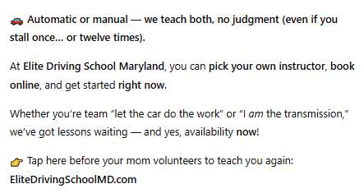
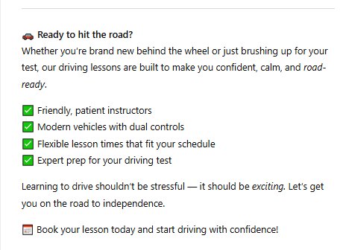
How to Use AI:
The Power of the Prompt
Write a very funny Facebook post about driving lessons offered by Elite Driving School in Maryland focusing on both auto and manual transmissions as well as the ability to book online after choosing their own instructor. Keep it brief, to the point ,friendly and professional. Also mention availability now please.
Write a facebook post about driving lessons
Notes:
“Prompt = Input. Precision = Power.”

Slide 16
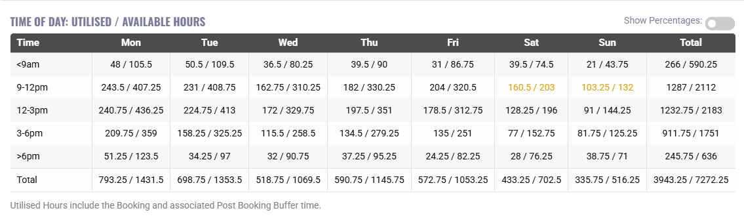
Data Prompt:
Single Region Hour Utilization
“Based on my current retail rates as well as the average commission rate, using this one-month utilization vs. available hours data for this location, analyze instructor capacity and student demand patterns. Recommend whether we should hire additional staff, and if so, specify which time blocks (days and hours) would provide the highest ROI and alleviate booking bottlenecks. Consider any holidays, if school is in session, or other societal impacts on our consumer base.”

Slide 17
Actionable AI Info:
What times/days to hire for:
🧠 Strategic Interpretation
This tells us a few critical things about the operations in this location:
  Weekend capacity is maxed. You’re hitting the wall on Saturday and Sunday mornings — any additional bookings there risk falling through without staff flexibility.
  Weekday hours are over-supplied. You have idle capacity Monday–Thursday that could absorb weekday overflow or reschedules.
  Customer preference drives weekend peaks. This isn’t a training volume issue — it’s behavioral. Students want weekend slots, and your system needs to flex around that.
👥 Hiring Strategy
Hire one additional instructor (or split between two part-timers) with a focus on weekend coverage, not weekdays.
Recommended Schedule:
  Saturday: 8:00 am – 1:00 pm
  Sunday: 8:00 am – 1:00 pm
  Friday (optional): 9:00 am – 12:00 pm if bookings continue trending upward
That’s 10–15 hours/week — enough to offload peak congestion without bloating payroll.
Role type:
  Casual or contract instructor (scalable hours).
  Cross-train in admin or student onboarding if you want weekday value-add coverage when bookings dip.
💰 ROI Framing
If your average lesson generates $150 and you’re losing even 10 weekend bookings per week due to lack of availability, you’re forfeiting ~$1,500/week. Hiring at ~$35/hour for 15 hours = $525/week.
That’s a nearly 3:1 ROI on recovered capacity — conservative, even before accounting for improved booking satisfaction and repeat business.

Slide 18
Actionable Info:
What times/days to hire for:
Sydney Staffing Strategy (Carrie Mae Version)
  Weekend mornings are maxed out; weekdays are bloated with idle time.
  Hire 1 part-time instructor for 10–15 hrs/week, focused on Sat & Sun 8 am–1 pm (add Fri 9–12 if growth continues).
  That single hire unlocks ~$1.5K/week in recoverable bookings for ~$525/week cost — a 3:1 ROI.
  No new weekday hires needed. Rebalance, don’t expand.

Slide 19
So What Now?
1
2
3
Gather Your Data
Centralize It
Automate With Purpose
(Seriously, all of it)
(This is where magic starts)
(Start with what hurts)
AI can’t optimize chaos. You need clean, consistent data — who’s teaching, who’s booking, who’s canceling, and when. If it lives in sticky notes and text messages or is stuck in software..... AI can’t find it - you can’t use it.
Put everything in one place — your lessons, students, payments, feedback and start building your prompts. Systems like BookingTimes already do that heavy lifting. The more connected your info, the smarter your AI can get.
Once your data’s in shape, let AI handle the grind: scheduling, reminders, basic customer service, procedures, reporting and summarizing your business. It’ll feel like hiring a silent, overachieving assistant who never sleeps or complains.

Slide 20
And with that being said.......Now, the good part
Meet Maverick

Slide 21



Questions or Comments?
The future of healthcare promises incredible advancements powered by artificial intelligence. AI is poised to revolutionize disease prevention, diagnosis, and treatment, paving the way for personalized medicine and improved patient outcomes.
More About BT
Download Presentation
Contact Carrie

